Slide 1
BITS Pilani
Dr.Aruna Malapati
Asst Professor
Department of CSIS

Slide 2
Extensions to Phrase based SMT

Slide 3
Today’s Agenda
Explore different features to extend SMT

Slide 4
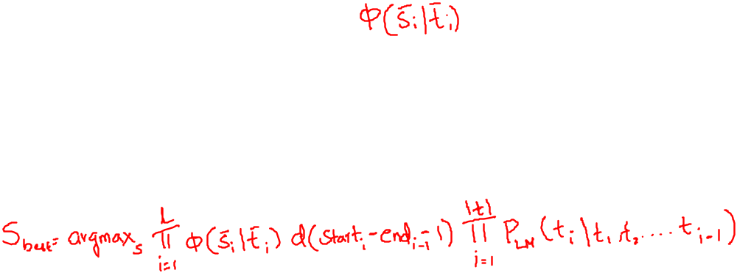
Log Linear Models
Phrase based SMT has three components in the model
  Phrase Translation table
  Reordering Model d
  Language Model P_{LM}
  Some sub-models may be more important than others

Slide 5

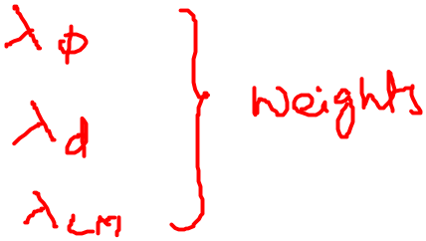
Log Linear Models (contd..)
To improve our model we may want to add weights to our model to ensure fluent output.

Slide 6
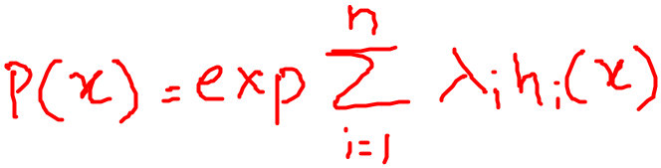
Log Linear Models (contd..)
A generic log linear model is of the form
Num of feature functions n=3
Random Variable x=(s,t,start,end)
Feature function h1=log ɸ
Feature function h2=log d
Feature function h3=log P_{LM}

Slide 7
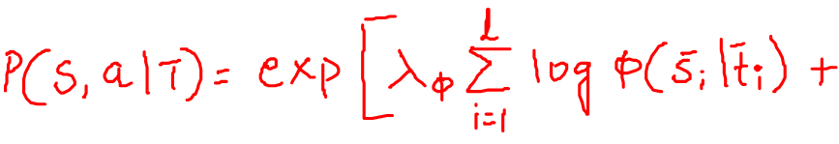
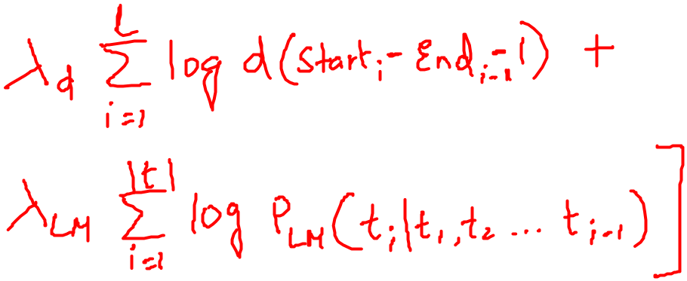
Log Linear Models (contd..)

Slide 8
Bidirectional Translation Probabilities
Using Bayes rule we have inverted the translation probability
P(T|S)=P(T) P(S|T) P(S)⁻¹
In the training data if an unusual phrase s is mistakenly mapped to common target phrase t then ɸ(s|t) will be high.
If the same phrase is encountered in test data this phase will score high.
Hence it is better to condition on the actual translation or use combinations schemes or weighted scheme for combinations.

Slide 9
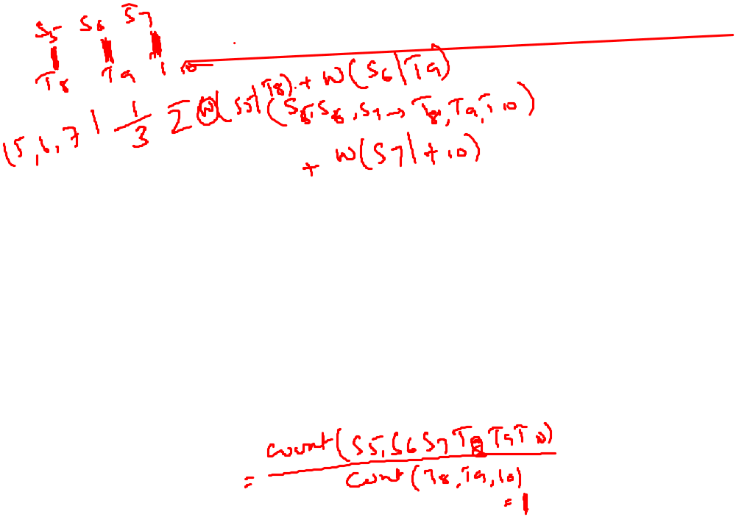
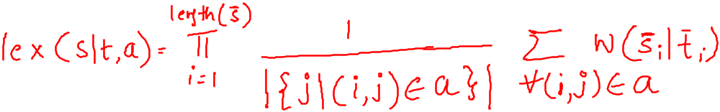
Lexical Weighting
Infrequent phrases pairs collected from noisy data are always troublesome.
They will have ɸ(s|t) = ɸ(t|s) =1 which overestimates how reliable rare phrases are.
To judge the reliability of rare phrases decompose it into word translations(lexical weighting).
If source word is aligned to multiple target words the average of the corresponding word translation probabilities is taken.

Slide 11
Word Penalty
Language model has a bias towards short translations.
We have not explicitly modeled the output length in terms of no of words. We introduce the word penalty factor ω for each produced word.
word count: wc(t) = log |t| ^{ω}
If ω < 1 we prefer shorter translations and if ω > 1 we prefer longer translations.

Slide 12

Phrase Penalty
Phrase segmentation is not explicitly modeled hence the assumption was that all phrases segmentations are equi probable.
To control whether shorter or longer are preferred we add another parameter ρ(phrase penalty) for each phrase translation.
If ρ < 1 we prefer fewer (longer) phrases and if ρ > 1 we prefer more (shorter) translations.

Slide 13
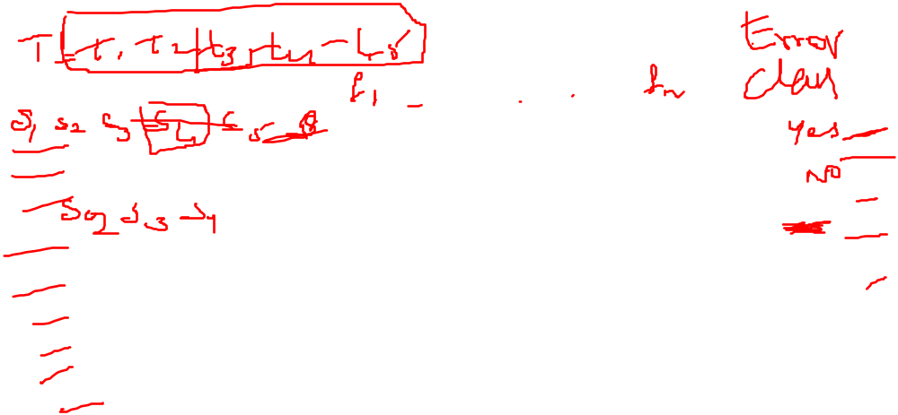
Phrase translation as a classification problem

Slide 14
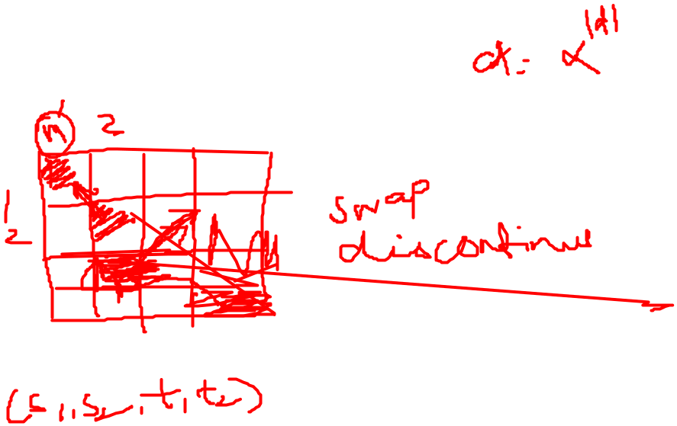
Reordering

Slide 15
Decoding

Slide 16
Evaluation of SMT
Bilingual evaluation understudy (BLEU) score
Given a machine generated output translation it allows to compute a score that measures how good was the translation.

Slide 17
Example - unigram
बिल्ली चटाई पर है
Reference1 : the cat is on the mat
Reference2 : there cat is on the mat
SMT output: the the the the the the the
Precision = 7/7 = 1
Modified Precision = 2/7
Modified Precision favors short translation.

Slide 18
Example-Bigram
Reference1 : the cat is on the mat
Reference2 : there cat is on the mat
SMT output: the cat the cat on the mat
Unique Bigrams Count Count_{clip}
the cat 2 1
cat the 1 0
cat on 1 1
on the 1 1
the mat 1 1
Modified Precision = 4/6

Slide 19

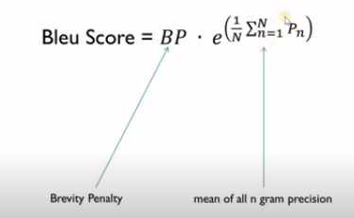
Brevity Penalty
R is the length of the reference sentence and c is the length of the MT sentence.

